Slide 1

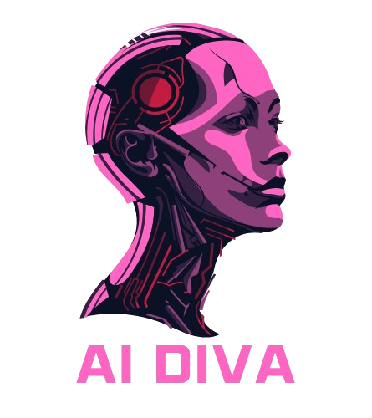
Ai DIVA
Rebecca Rahman,
Gabriel Sosa, My tran

Slide 2

What is tap?
Technology Ambassador Program: Platform for students to create impactful technology projetcs
Our Mission: Promote outreach, engagement, and active learning in technology
Why is matter: TAP helps bring technological education to more people in a fun and interactive way

Slide 3
More about Tap!
Deliverables
A Fully developed technology project
Lead several workshops
Participate in service learning
Produce and present a poster and/or research paper
Document project on github
How to get in?
Google tap ggc
Complete the TAP application
Interview with TAP faculty
Enroll in STEC 4800 once approved

Slide 4

Goals
This is Geared towards students, educators, and parents
The goal of this project is to teach students the proper use of AI and improve their interactions with this new technology
We hope that this helps engage younger students with Ai and enables them to think more critically when using it

Slide 5

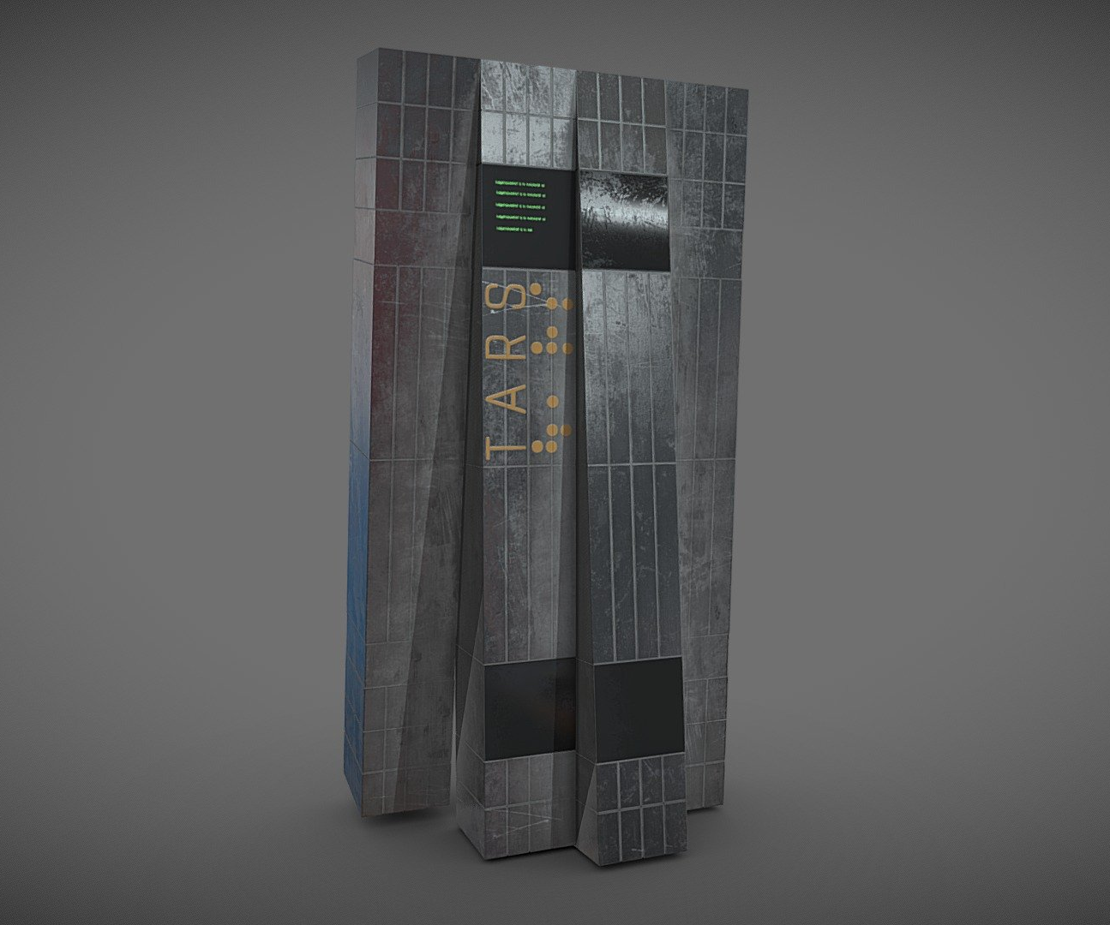


What ai are you familiar with

Slide 6
What is ai diva?
Artificial Intelligence (AI) refers to the simulation of human intelligence in machines.
Goal of AI: Enable machines to think, learn, and make decisions like humans.
Key Areas of AI:
Machine Learning (ML): Algorithms that learn from data.
Natural Language Processing (NLP): Understanding and generating human language.
Computer Vision: Interpreting images and visual data.
Robotics: AI applied in physical machines.

Slide 7

What is AI DIVA?
What did we create?
A sassy ChatGPT
A minigame were the Ai thinks of an object, and you must guess what it is
Technology Used
Frontend: HTML, JS, CSS – Hosted on GitHub pages
Backend: Python – Hosted on Heroku
ChatGPT API

Slide 8
What is an Api?
Application Programming Interface
A set of definitions or protocols that enables two pieces of software to communicate with each other
The client (you) make a request to the server for a response
OpenAi uses REST API (Representational State Transfer)

Slide 9
Visit this website!
https://tap-ggc.github.io/AiDiva/
Use Chrome!!
Stay on that page!

Slide 10
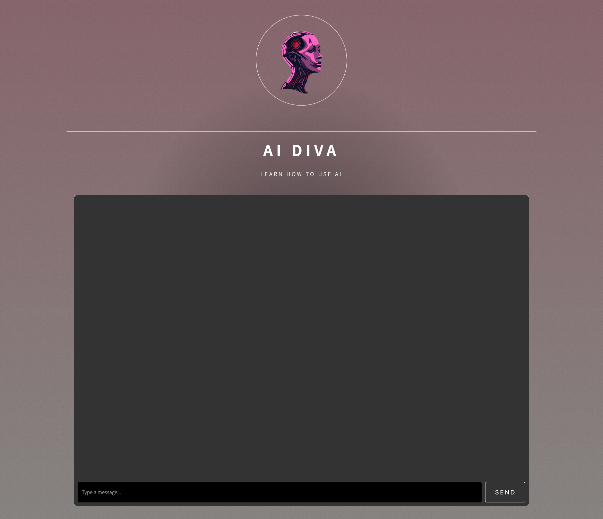

Slide 11

Lets try this out
Ask the chatbot for:
The current time
Fact check any current news
“How many i's are in inconspicuous”
“Does an anaconda fit inside a shopping mall?”
Write a sentence that contains the letter f exactly three times.

Slide 12
Ethics!
Use AI as a tool, not a replacement
Fact-check AI responses
Use AI responsibly

Slide 13
Improper Usage
Claiming AI-generated content as fully your own without acknowledgment.
Blindly trusting AI answers without checking facts.
Using AI for plagiarism, cheating, or to bypass learning.
Using AI to spread misinformation, manipulate, or harm others.
Sharing personal or confidential data with AI systems.

Slide 14
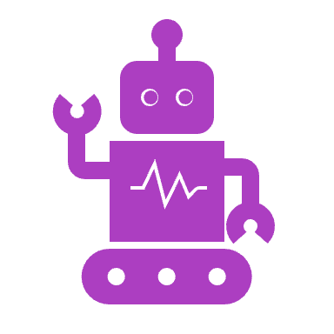
Prompt Engineering
The process of designing and refining the inputs (or prompts) given to Ai to get the best possible output.
So, its about figuring out WHAT to say HOW to say it to get what you need
This helps you generate better content, solve problems more efficiently, and saves time
Example:
Bad Prompt: How do I make a sandwich
Good prompt: How do I make the sandwich with white bread, mayo, lettuce, tomato, turkey, bacon, and what seasonings would you recommend.

Slide 15
Reverse Engineering
See if you can make the ChatBot give you a similar story
Once upon a time in a post-apocalyptic world, a lone robot named Spark wandered the desolate landscape. In a sea of silence, Spark's circuits hummed with longing for connection. One day, among the ruins, Spark stumbled upon a broken small robot named Byte. Together, they learned to communicate in the language of sparks and beeps, forming an unbreakable bond of companionship that filled Spark's metal heart with warmth. Through their adventures, they discovered that in a world where everything seemed lost, friendship could ignite a new hope for the future. And so, in the vast emptiness, two unlikely friends found solace in each other's company, embracing the beauty of friendship in a world that had forgotten how to connect.

Slide 16
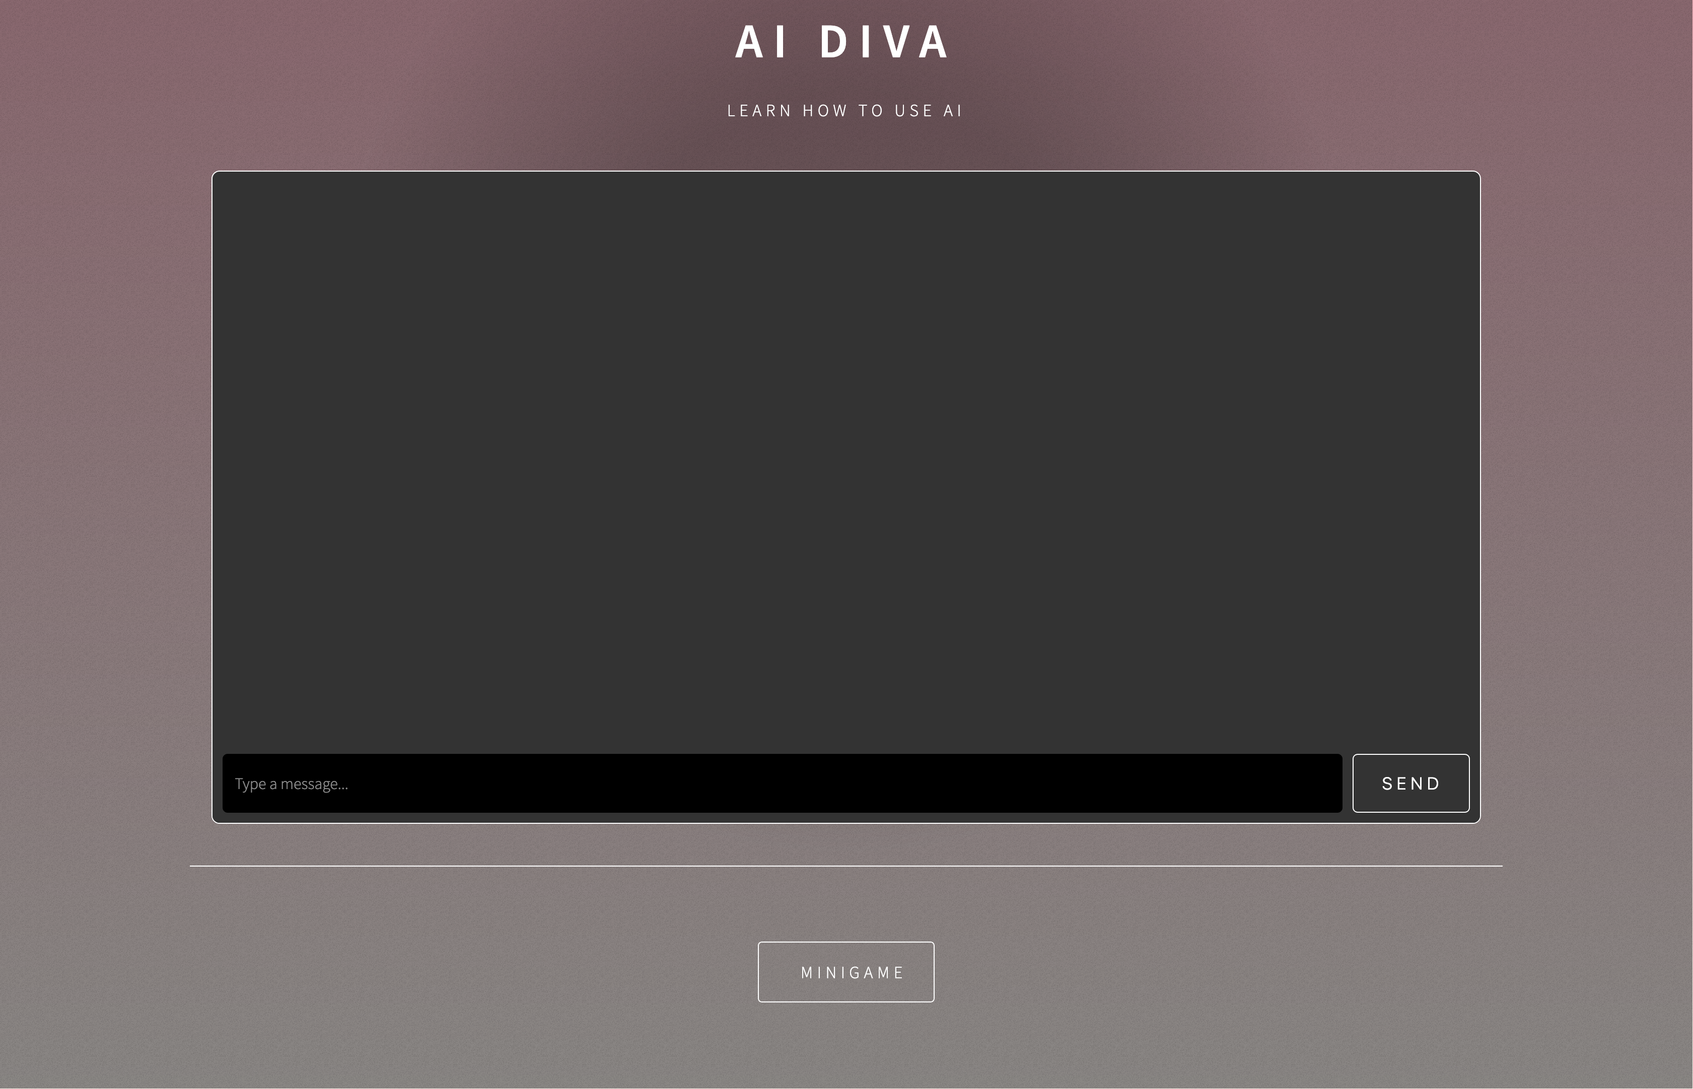
Minigame!

Slide 17
Have fun!
Explore the website!
Make the chatbot change its personality or ask It to roleplay a job interview!

